Slide 1
Unit 1
Text A Half a Day
Contemporary College English (Book 1)
English Majors (Grade One)
Contestant No. :

Slide 2
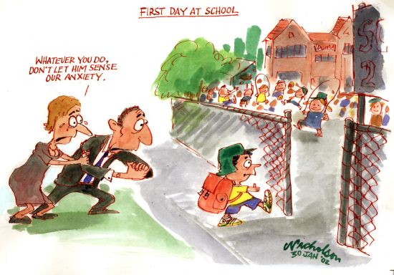
Warming-up Discussion
First day of school …

Slide 3
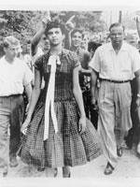
First day at school …
In 1957, fifteen-year-old Dorothy Geraldine Counts and three other students became the first African American students to attend the previously all white Harding High School in Charlotte, North Carolina.

Slide 4
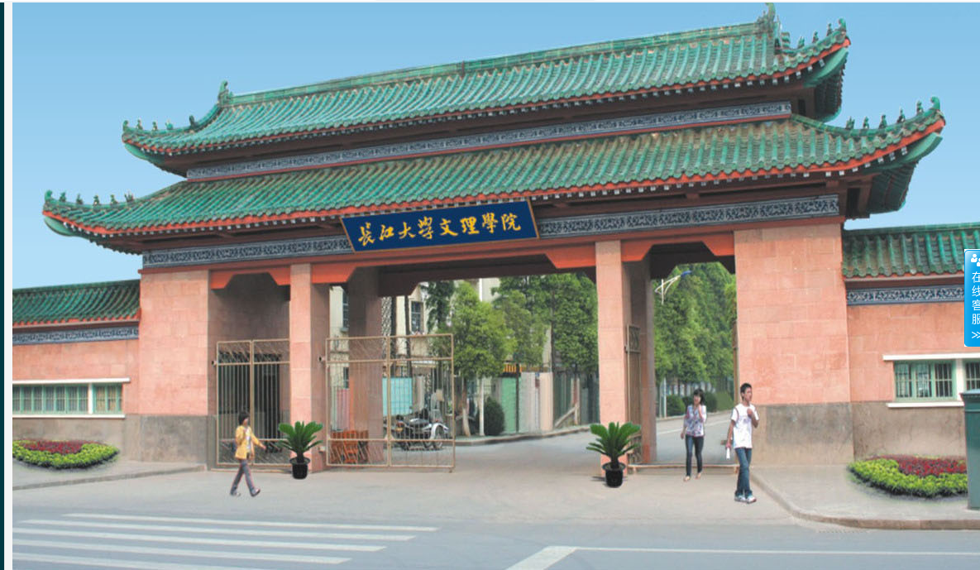
Your first day at college …
frightened
?
excited
lonely
puzzled

Slide 5
Unit 1
Text A Half a Day
Contemporary College English (Book 1)
English Majors (Grade One)

Slide 6
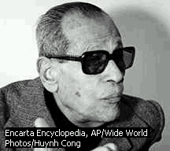
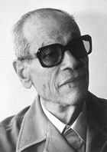
Naguib Mahfouz 1911-2006
Born in 1911, educated at Cairo University
Wrote short stories and historical novels before WWII
Turned to write novels of social realism after WWII
Later works combined realism & symbolism
A prolific writer: no fewer than 30 novels, more than 100 short stories, and more than 200 articles.

Slide 7


His Works
The Cairo Trilogy: Palace Walk, Palace of Desire, Sugar Street (first published 1957)
The Time and Place and Other Stories, 1991

Slide 8
His Influence
The first Arab Writer to
win the Nobel Prize
in Literature –
1988, The Cairo Trilogy
Depicts realistically the
social and political life in Egypt
His classical and lucid style rejuvenated literary Arabic without recourse to colloquialisms
… through works rich in nuance - now clear-sightedly realistic, now evocatively ambiguous - has formed an Arabian narrative art that applies to all mankind
"a Dickens of the Cairo cafés" and "the Balzac of Egypt".

Slide 9
Underlying Implications
Do you think the sudden change of the boy’s age symbolizes something?
Do you think the boy’s first day at school symbolizes something?

Slide 10
Allegory
A literary, dramatic, or pictorial device in which characters and events stand for abstract ideas, principles, or forces, so that the literal sense has or suggests a parallel, deeper symbolic sense. (寓言，讽喻一种文学、戏剧或绘画的艺术手法，其中人物和事件代表抽象的观点、原则或支配力，从而使表面含义含有或表达一种对等的，但更深刻的象征意义)
A story, picture, or play in which this device is used. John Bunyan's Pilgrim's Progress and Herman Melville's Moby Dick are allegories. (寓言体小说，寓意画，寓言剧运用这种寓言艺术手法而作的小说、绘画或戏剧。约翰·班扬的 《天路历程》和赫尔曼·麦尔维尔的 《白鲸记》都是寓言体作品)

Slide 11
Tasks for Today
Ⅰ Text Appreciation
1.Text analysis
2.Theme analysis
3.Sentence understanding
Ⅱ Critical Thinking
Ⅲ Summary
Ⅳ Assignments

Slide 12
Objectives
1. To understand the main idea and the theme of the text
2. To learn the key language expressions and grammatical points
3. To cultivate the critical thinking ability

Slide 13
Task I Text Appreciation
1. Text analysis
2. Theme analysis
3. Sentence understanding

Slide 14
1.Text Analysis
Before school
At school
After school

Slide 15
1.Text Analysis
Before school
The boy’s
misgivings about
school
Why?

Slide 16
1.Text Analysis
At school
The boy’s life experience at school
What?

Slide 17
1.Text Analysis
After school
The changes found by the boy after school
How?

Slide 18
1.Text Analysis
Before school
It is about the boy’s experience of his first day at school.
At school
After school

Slide 19
2.Theme Analysis
BRAINSTORM:
What is the theme?
School can change a person’s view on the world.

Slide 20
3. Sentence Understanding
clutching
1)I walked alongside my father, his right hand. (para.1)
present participle as
accompanying adverbial
Notes:
Do you know how the author illustrates the main idea and the theme of the text? We are going to appreciate two sentences and they will tell us the process of psychological changes of the boy towards school.

Slide 21
3. Sentence Understanding
2) The time for changing one’s mind was over and gone and there was no question of ever returning to the paradise of home. Nothing lay ahead of us but exertion, struggle and perseverance.(para.15)
此时改变主意已晚，我们再也不能回到天堂般的家里去了，摆在我们面前的只有努力、奋斗和坚持。
Notes:
Please follow me. Read the sentence . Then, find student to translate the sentence into Chinese, and especially, students should pay attention to the words in blue.

Slide 22
Task II Critical Thinking
Look and Think.
School is a place that makes useful citizens out of boys and girls.
Notes:
图片展示 What enlightenment can we get from the text appreciation? Now, it depends on our critical thinking.

Slide 23
Task II Critical Thinking
What we need to do is just making our minds to challenge ourselves, finding the changes and to change them in a positive way. Only in this way can we succeed!
(From the book: Who Moved My Cheese)

Slide 24
Task II Critical Thinking
meeting challenges
School
Changes
facing difficulties
making decisions
Notes:
School can change us. What can school influence us?

Slide 25
Ⅲ Summary
Critical
thinking
Main idea
Half a Day
Sentence understanding
Theme

Slide 26
Ⅳ Assignments
1.Write an essay of about 150 words on “How the Boy Changed His Idea of School”.
2.Watch the video titled University Life from TED.

Slide 27
Thanks！

